Slide 1
TV Speciales 2012

Slide 2
Agenda for kick off 8 Dec at 12pm PST
Participants: Cristian Faber, David Karr, Adam, Kelly, Jan, Kathleen, Christoffer, Threshold
Intro to Hero Factory – Cristian Faber
Intro to 2012 Overall 360 Marketing Concept -Jan
Script Brief 2012 – Jan/Kathleen
Intro to 2012 models/personalities – David/Christoffer

Slide 3
Script Brief
Task
  To produce the script for 2*22 min TV specials in high quality CGI format, that we are able to cut a number of smaller mini movies (1-2 min each), where we follow some of our heroes trying to catch a villain
Story
  Takes the starting point in the breakout story
    All villains & monsters ever captured break out of the Hero Factory, all hell breaks lose in the galaxy
    Heroes gear up with new equipment, where the most important is the new Hero cuff – (not shooting)
    We follow each of the heroes on their quest to bring back the villains – which is not successful
    Villains gang up to get revenge and get even with Hero Factory (reason to fight)
    Final show down at the factory itself, Heroes succeed at the end!
Frames
  A total of 12 models can be used
  Reuse existing settings and support models non key scenes
  A number of new settings can be added for key scenes
Timing
  Briefing – week 49 JFA/Kathleen
  Story team to meet incl. Adam week 49/50 JFA/Kathleen
  Synopsis / debrief week 51 Story Team, but led by Adv.
  Treatment version 1 week 1 Adam input from Story Team
  Treatment version 2 Week 2 Adam input from Story Team
  Script version 1 Week 5 Adam
  Script final week 7 Adam
Mandatory's
  Role of Hero Factory should be more active and exiting, currently it’s “just” a command base, needs to be a fun existing place, showing an exiting jail, weapon storage facility etc.
  Individual missions that our heroes embark on needs to be a matter of saving the universe every time (needs a very strong reason to fight)
  Humor needs to be predominantly visual – slapstick type humor – keep it simple.
  Keep villains as bad guys and heroes as good guys – be careful not to undermine their iconicness
  Lot’s of action and fighting, but not in a dark and scary way.
  Make the action and fighting playable - imaging how kids can play this using a few figures and stuff they have in in their room => will make them buy even more!

Slide 4
Hero Factory 2012 Story Team
Members
Story team: David Carr, Kelly, Christian Faber, Christoffer Raundahl
Approvers: Kathleen, Jan
Writer: Adam
Process:
Brief and Scope – Approvers + Threshold.
Story synopsis - Story team + writer
Treatment – writer, checking in with story team, prior to delivery to approvers
Script: Writer-Adam
Background
To secure a faster and more streamlined development of stories
Better utilization of produced assets across marketing platforms
Utilize learning’s from past Bionicle / Hero Factory developments

Slide 5
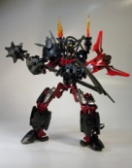
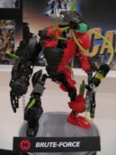
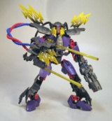
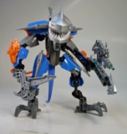
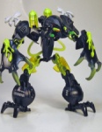
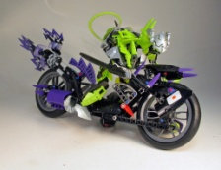
Roles of the Villains
After many years in prison Over-Lord and his minions are determined that no Hero
shall ever be built in the Hero Factory again!
Over-Lord
Leader and mastermind
behind the break-out
Brute Force
Kill Switch
Depth Charge
Plague Reapa
Speeda Demon
The Muscle of
the team
High voltage – can take out all
HF operating systems
Inject virus into both
People and computers
Inject virus into robots
Hells Angel gone bad

Slide 6
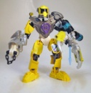
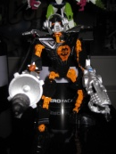
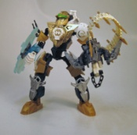
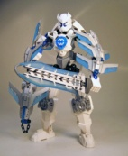
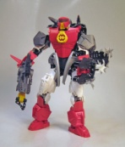
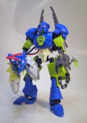
Key Heroes
EVO
STRINGER
ROCKA
STORMER
FURNO
SURGE

Slide 7
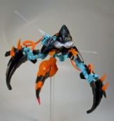
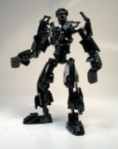

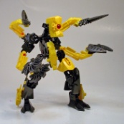
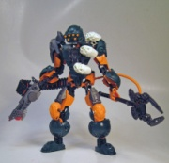
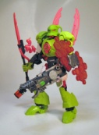
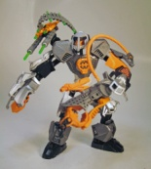
2012 Assortment Structure – Global
Novelties
Novelties
1 HY
2 HY
€ 8.99
€12.99
US 2. HY
€ 19.99
€ 29.99
10 Novelties
8 Novelties
Total of 18 Novelties
Beige framing = Hero
Red framing =Villain

Slide 8
2012 Assortment Structure - Global
1 HY
2 HY
€ 8.99
€12.99
€ 19.99
€ 8.99
€12.99
€ 19.99
€ 29.99
Mission 1
Mission 2
Mission 3
Mission 4
Mission 5
Mission 6
Mission 7
Mission 8
Mission 9
TVC 1
TVC 1
TVC 3
TVC 3
TVC 4
TVC 4
US 2. HY
TVC 2
TVC 2
10 Novelties
8 Novelties
Beige framing = Hero
Red framing =Villain

