Slide 1
BIONICLE Brand Research in the UK
Qualitative Research with boys
Aged 6 – 11 years
Conducted by ChildWise, UK

Slide 2
Table of Contents
Methodology
Research Objectives
BIONICLE Brand
BIONICLE Boys
BIONICLE Product
BIONICLE Packaging
BIONICLE Mums
BIONICLE Website
BIONICLE Media
LEGO Hero Factory

Slide 3
The Methodology
12 paired depths with boys age 6-11:
  Current Bionicle users, excluding “fanatics”
  Lapsed users – not in past 6 months
  Non users – never owned, but aware, non rejectors, own / play with similar ranges
  Friendship pairs in home
  All BC1C2
  Age: 6-8 and 9-11
  Surrey / Hants, Hertfordshire, West Midlands, Norfolk
  Fieldwork dates 25 April – 7 May 2009

Slide 4
Sample Detail
 | CURRENT USERS | LAPSED USERS | NON USERS
HERTS | Age 6 and 7 | Both age 11 | Both age 8
SURREY / HANTS | Both age 8 | Both age 10 | Age 6 and 8
NORFOLK | Age 9 and 10 | Both age 8 | Both age 6
WEST MIDLANDS | Both age 10 | Both age 7 | Age 9 and 11
TOTAL | 4 pairs - 2 x 6-8 - 2 x 9-11 | 4 pairs* - 2 x 6-8 - 2 x 9-11 | 4 pairs - 3 x 6-8 - 1 x 9-11

Slide 5







The Competitors
GAMES CONSOLE
DS
others
OTHER ACTION FIGURES
INTERNET
LEGO RANGES
Star Wars, City, Indiana Jones, Spiderman
Car kits
K’nex
Notes:
Overall:
A wide and growing choice of options
Games consoles, and to a lesser extent internet, in close competition – including toy brand games
Wide choice of action figures, including new ranges with strong TV / film support, eg Ben 10
Also a wide choice of Lego ranges, including Star Wars, Indiana Jones, Spiderman

Slide 6
Research Objectives
To understand the Bionicle brand in the UK
  Is the brand cool, is it suffering from wear-out, does it need new news?
To understand the Bionicle consumer
  Who is the Bionicle boy – are they LEGO or action figure boys or both?

Slide 7
The Brand
Currently the brand lack sufficient diversity to carry boys for more than a few years
Boys have mixed views on Bionicle – space, aliens, dragons, robots
The majority of boys have little or no knowledge of the story
For competing brands (Ben 10, Transformers) the story is supported by TV or film and therefore more easily understood
Recommendations:
An attractive, easy to grasp and new storyline with new products could rejuvenate the category
TV or film support would keep the products front of mind, provide new storylines and character information
A basic storyline framework is needed to introduce the products to boys – they would then use their imagination when playing

Slide 8
The Engine
Cool models
Battle
Build
Three strands – re-enforcing involvement

Slide 9
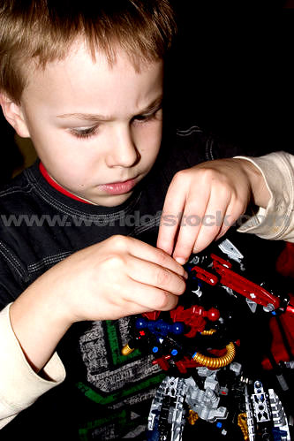
PLAYING BIONICLE - Building
BUILDING –
But also
Adapting / Customising
New ideas
Improvising
Notes:
Building – also adapting / customising, creating new versions, improvising – adding stickers, swapping limbs, making giant figures, using other Lego components
Gaining confidence and familiarity, enjoying the satisfaction of building and creating without being overwhelmed
Initial construction is a challenge to some, even keen users may need to get help – parent, sibling

Slide 10
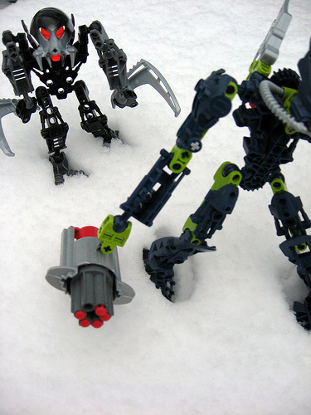
PLAYING BIONICLE - Battling
BATTLING –
Unstructured fights
Tournaments
Matching special powers
Notes:
Acting out – battling, staged fights or tournaments (sometimes against other toys eg action Lego, WWE), also scenarios involving powers / skills (sometimes the official ones, but often made up)
Bionicle don’t work that well for hand-to-hand fights – younger children
Others look at different powers, work out who would win
Spikeball – some practical problems, not all find the instructions

Slide 11
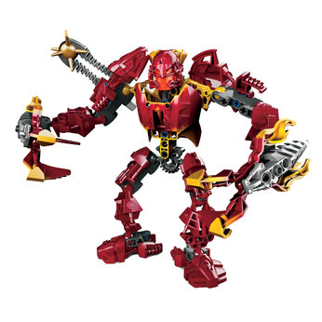
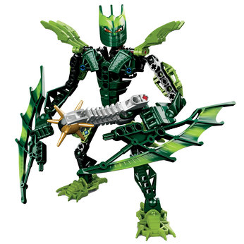
PLAYING BIONICLE - Playing
PLAYING –
Posing
Discovering
Displaying
Discussing
…. Deeper involvement
Notes:
Admiring / discussing / discovering – posing their figures, looking at details, comparing with friends
A third strand beyond battling and building
Comparing, working out how the various bits link to the colour them, experimenting – getting closer to the figures, deeper involvement

Slide 12
The Boys
Most boys see BIONILCE as for a younger age range – however the younger boys find the products difficult to build
Users split into enthusiasts (not as dedicated as fanatics) and players
  Enthusiasts – visit the website, are familiar with some of the names and storyline
  Players – focus on the products and not story, use their imagination, play with BIONICLE in turn with other brands
Lapsed users split into older boys and younger boys
  Older boys – outgrown BIONICLE, less interest in action figures as a whole
  Younger boys – BIONICLE out of favour to other brands, don’t fully appreciate BIONICLE – open to re-visiting the brand
Non users seem to have no clear interest in the brand, other brands are more exciting
  Star Wars, Ben 10, other LEGO
Recommendations:
Opportunity to target lapsed younger users and remind them about the brand

Slide 13
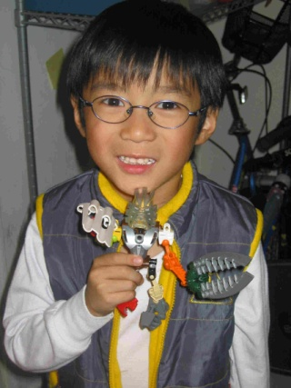
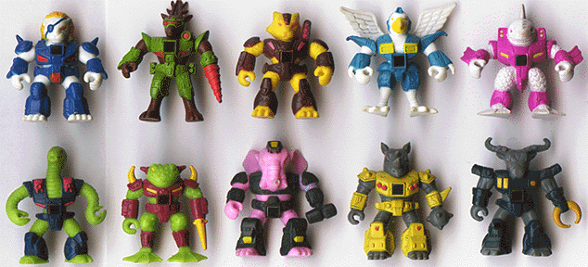
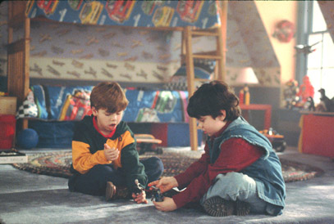
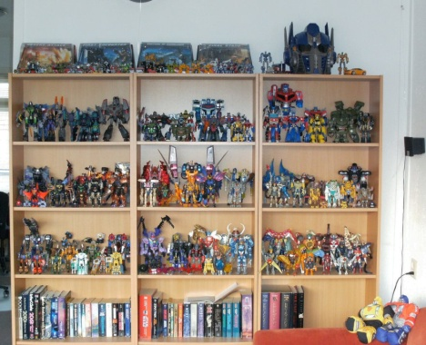

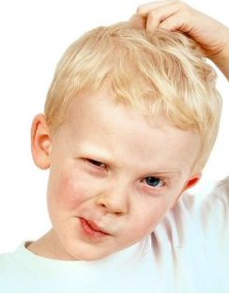
The Users
ACTION
CREATIVE
EXCITING
COOL
BATTLE
STRENGTH
FRIENDS
EVERYONE
BUILD
DIFFICULT
Notes:
Bionicle users (cont’d)
Awareness / first introduction:
via older brothers, cousins
introduced via TV adverts
friends who own this
given to them as gifts
Purchasing – relatively few bought their own figures, some of the older boys talked about getting the smaller figures for themselves, larger figures as birthday or Christmas gifts. Some had particularly enjoyed the larger sets (especially the vehicles) which they had not seen recently. They see these in Tesco etc, also in the local toy shop or newsagents – less likely to visit Toys R Us, so less chance to see the range there.
Most had a limited perception of the actual extent of the range – they know that there are several different colours, and that new series are regularly introduced, but most don’t know exactly which ones they already have – or what they would like to get next.
Most, but not all, know that Bionicle are from Lego – the logo on the box, the Lego-style parts. Some see it as part of a continuum that includes other Lego ranges such as Spiderman, Star Wars, Indiana Jones.
Mum’s role is widely relevant, as is Dad’s in some cases – helping with the building, helping keep their toys organised / stored safely, understanding that they will come back to things after a break.

Slide 14

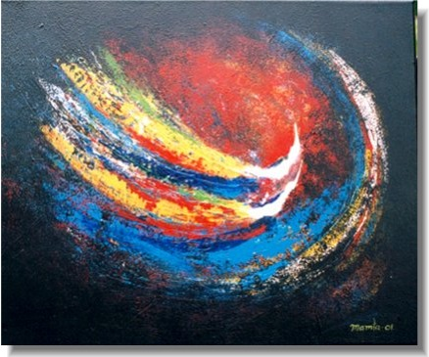
The Lapsed Users
FRIENDS
BUILD
BATTLE
YOUNGER
ANNOYING
FRIGHTENING
CREATIVE
COOL
EXCITING
OLDER
EVERYONE
ALONE
Notes:
Lapsed Bionicle users (cont’d)
Parents, especially mum, can play an important role in enabling or preventing continued involvement, often encouraging children to sort out and discard toys they haven’t played with recently or appear to have outgrown – this works against a toy that may be enjoyed on a less regular basis
passed down to younger brothers / cousins
sold
thrown away – broken / damaged
some children feel that they are forced to get rid of toys they would like to have kept – make space for new ones / siblings toys
Role of story, film, website – this is harder to find than for competing ranges, so boys are less likely to get reinforcement or reminders about the range.

Slide 15
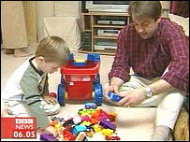
The Non Users
BATTLE
BORING
YOUNGER
BUILD
DIFFICULT
CONFUSING
ACTION
FRIENDS
EVERYONE
OLDER

Slide 16
The Product
BIONICLE figures are seen as appealing (although can often go un-noticed in store)
  The overall design, weapons and tribal aspect are liked
Many boys like to adapt and customise their figures – creating their own versions
However:
The sheer volume of similar characters makes it hard for boys to keep track of who they’ve got and who they need
  Makes it very difficult for boys to identify where they have gaps
  The difficulty of pronouncing and even finding the character names adds to this
The characters seem quite similar (nothing new) and don’t have enough functionality
  Buttons to press, armour on back, retractable parts
Recommendations:
Fact cards (top trumps) in pack – to understand the characters/powers/tribes
Accessory packs – stickers, additional customising or building ideas
Designs that have additional features e.g. roll up into a ball

Slide 17
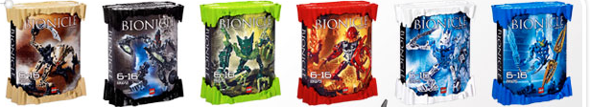
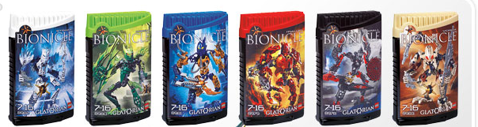
The Packaging
+ve
Front of pack pictures – attractive, communicate different colours
Work well when the whole range is displayed
Attraction on shelf
-ve
Boxes fall short in functional terms
Limited on pack communication beyond the specific model
Limited communication from instruction leaflets
Pack could provide a greater contribution to child’s involvement

Slide 18
The Packaging
The packaging is seen as colourful and attractive but….
The large box is hard to open and when the lid id taken off the name is lost
The small box is not very robust and gets damaged easily
The packs are seen as a step backwards from earlier packaging designs
  Information on pack is often missed – website, codes etc.
The biggest issue is storage – the product does not fit back into the can and means that parts are often lost, or mum tidies the product out of the way and it is forgotten about.
The building instruction has limited success in communicating the range
  Many boys fail to spot the extra information and the BI often gets thrown away
Recommendations:
Although the packaging is attractive it can be much better
  It could provide greater contribution to boys involvement
Make the BI easier to fold, put the names of the other characters on the leaflet
  Any key information such as range cross sell, character bios etc. needs to be at the front of the leaflet

Slide 19
The Mums
Mums are key
  Mum’s support is important – they are needed for help with building and keeping products safe (tidying them away and not losing pieces)
Mums need to be able to get involved and be convinced about BIONICLE but they often aren’t
  BIONICLE can sometimes seem like too much bother and mums can steer boys into other easier brands
  They don’t need to understand the finer details of BIONICLE but just enough to believe that it’s worth getting
  As most parents have no previous experience of BIONICLE they need to understand how to build it – particularly for younger fans of BIONICLE
Recommendations:
Need to help mums get involved with BIONICLE
  Increase the support and information available
  Distance Bionicle from more violent brands such as WWE and Power Rangers (Bionicle can sometimes seem too violent)
Storage
  Need to keep the collection tidy and store safely

Slide 20
The Website
BIONICLE enthusiasts are more likely to use Bionicle.co.uk (although only two boys out of the research had visited the website)
  Use the website for games, entering codes, looking at characters
The majority of boys hadn’t visited the website and hadn’t thought about visiting it.
The story is too difficult to follow on the website – too text heavy
The website is difficult to find from LEGO.com
  Boys didn’t know where to go or where to find it
Recommendations:
Bionicle.co.uk needs to be more prominent
  Bigger on pack & BI
  Stickers with website on to share with your friends
The BIONICLE story could be depicted in cartoon strip style so that it was easier for boys to understand.

Slide 21
The Media
TV is the most important media – both children’s channels and beyond (e.g. Sky3)
The Internet varies in use by age, type of boy and parental control
  Most boys use the internet intermittently (games consoles more important)
  Games sites such as mini clip are the most popular
  Younger boys (BIONICLE target) don’t use the internet as much as older boys – 8+ (although 64% of 7-10 year olds use the internet)
The majority of competing products have a TV campaign to support the brand
  Allows boys to understand the storyline and concept easily
  It a way of getting the products talked about in school, with friends etc.
Recommendations:
Look at non traditional channels that are watched by children e.g. Sky 3
Print campaign
  A way of getting across the basics of the BIONICLE storyline
  Can target parents – can help mum understand the brand
  Cover mounts can offer additional value
  Can drive people to the BIONICLE website

Slide 22
LEGO Hero Factory
The Product
The boys thought the products looked more exciting as they had stickers on them, which there hasn’t been before
The 2010 figures have wide appeal with users, lapsed users and non users
  Most claimed to like them more than the current figures
  They were keen to play with them and see what they could do
The Concept
The H is the unifier (team, hero)
The storyline is much more accessible but potentially less unique as a result
  Its attractive and easy to grasp and boys can use it as a springboard for their own ideas
The Marketing Platform
A number of potential marketing ideas were presented to the boys
  They particularly liked the idea of being able to log on to the website and view a webcam to see what is going on in the factory – although this would need to be promoted
  They also wanted to be able to build their own hero online (not prompted)

Slide 23
Key Take Aways 1:2
The Brand
  Suffers from wear out
  It is less clear in the minds of the consumers
  The BIONICLE engine is still very much relevant: Cool figure, build, battling
The Boys
  Users
    Key words: Action, Cool, Creative, Exciting – but difficult to build
  Lapsed users
    Key words: Younger, Friends, Build, Battle
  Non-users
    Key words: Battle, Boring, Younger
The Product
  Seems to be the same launch after launch – lack of differentiation
The Packaging
  Optimise use of play starters
  Enhance communication of other initiatives from BIONICLE
  Make sure the product actually fits into the can

Slide 24
Key Take Aways 2:2
The Mums
  Important to get their support
The Website
  Less text heavy
  Increase presence to guide the boys to the website
The Media
  Remember to include more non-web media
  TV Series / DTV is the right way to go
LEGO Hero Factory
  Wide appeal among the consumer categories
  Liked the easy entrance to the universe via story starters
  Inspired by the possible web-campaign
  Products were seen a new and exciting (stickers)

